Slide 1
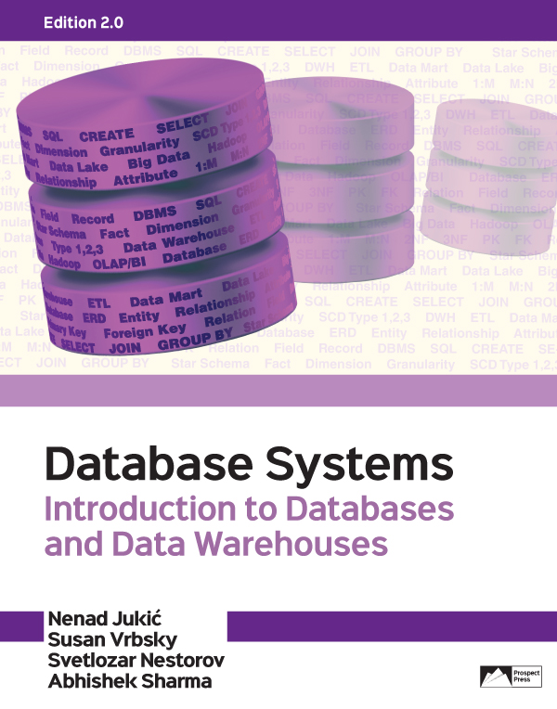
CHAPTER 2 - Database Requirements and ER Modeling
For exclusive use with:

Slide 2
INTRODUCTION
Entity-relationship (ER) modeling - conceptual database modeling technique
Enables the structuring and organizing of the requirements collection process
Provides a way to graphically represent the requirements
ER diagram (ERD) - the result of ER modeling
Serves as a blueprint for the database

Slide 3
ENTITIES
Entities - constructs that represent what the database keeps track of
The basic building blocks of an ER diagram
Represent various real world notions, such as people, places, objects, events, items, and other concepts
Within one ERD each entity must have a different name
Notes:
An ER diagram for a retail company may contain entities, such as CUSTOMER, STORE, PRODUCT and SALES TRANSACTION.

Slide 4
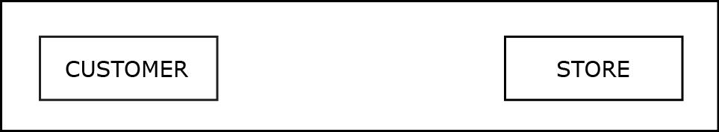
ENTITIES
Two entities

Slide 5
ENTITIES
Entity instances (entity members) - occurrences of an entity
Entities themselves are depicted in the ER diagrams while entity instances are not
Entity instances are eventually recorded in the database that is created based on the ER diagram
Notes:
Each depicted entity contains a number of entity instances or entity members. For example entity CUSTOMER may contain entity instances such as customer Joe, customer Sue, and customer Pat.

Slide 6
ATTRIBUTES
Attribute - depiction of a characteristic of an entity
Represents the details that will be recorded for each entity instance
Within one entity, each attribute must have a different name
Unique Attribute - attribute whose value is different for each entity instance
Every regular entity must have at least one unique attribute

Slide 7
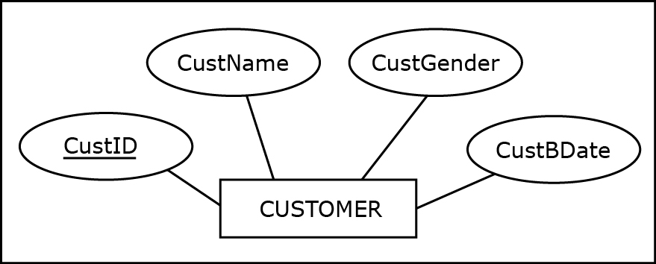
ATTRIBUTES
An entity with attributes
Notes:
This example is discussed on Page 16.

Slide 8
RELATIONSHIPS
Relationship - ER modeling construct depicting how entities are related
Within an ER diagram, each entity must be related to at least one other entity via a relationship

Slide 9
RELATIONSHIPS
Cardinality constraints - depict how many instances of one entity can be associated with instances of another entity
Maximum cardinality
One (represented by a straight bar: I)
Many (represented by a crow’s foot symbol)
Minimum cardinality (participation)
Optional (represented by a circular symbol: 0)
Mandatory (represented by a straight bar: I)

Slide 10
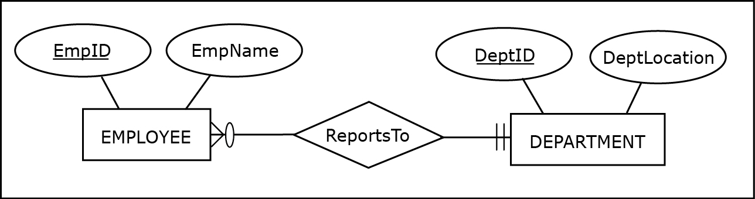
RELATIONSHIPS
A relationship between two entities
Notes:
The requirements for the relationship ReportsTo and the rules for interpreting cardinality constraints are given on Pages 17-18.

Slide 11
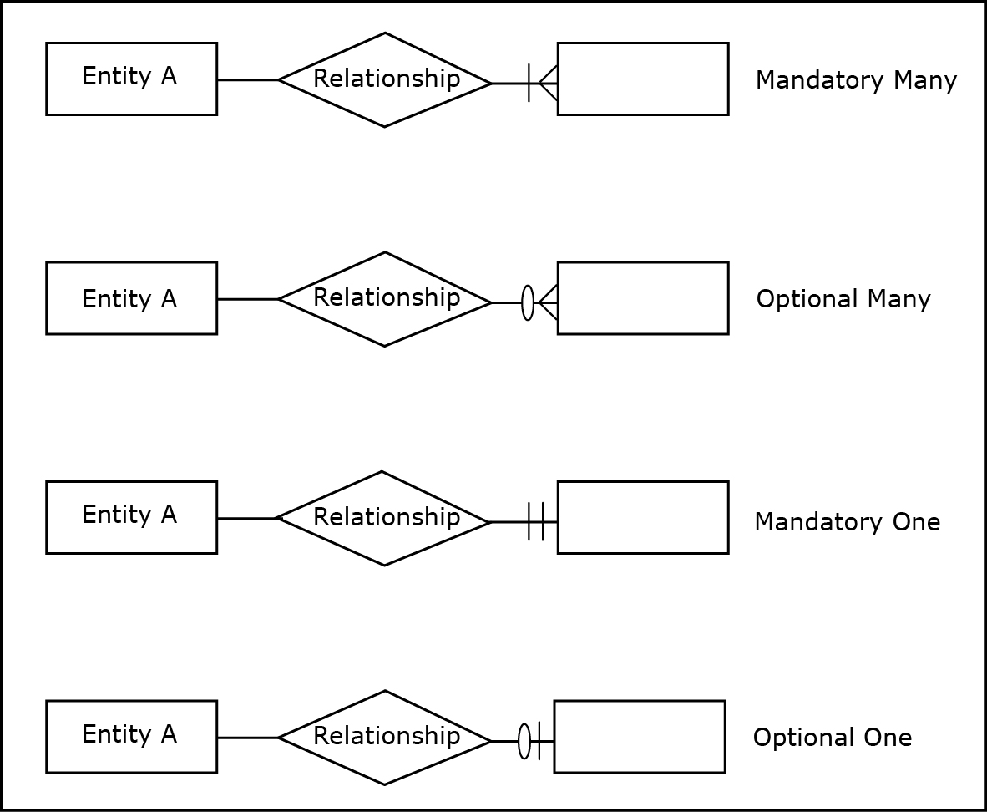
RELATIONSHIPS
Four possible cardinality constraints

Slide 12
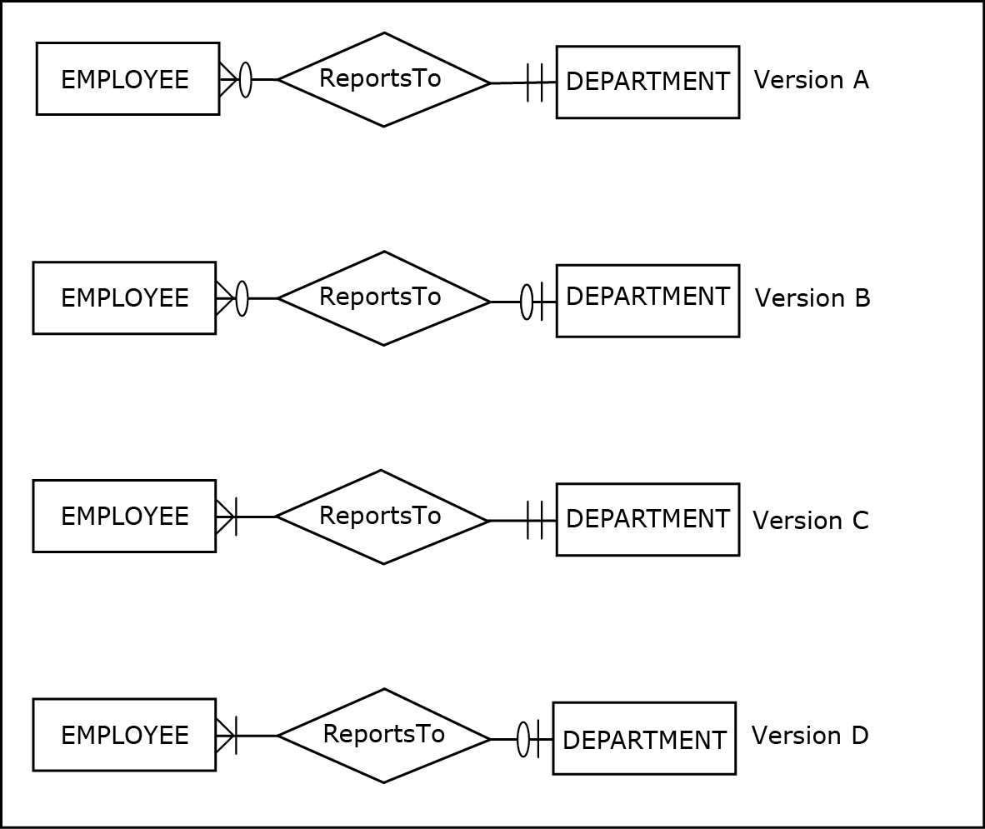
RELATIONSHIPS
Several possible versions of the relationship ReportsTo
Notes:
The requirements for each of the versions shown are given on Pages 18-19.

Slide 13
RELATIONSHIPS
Types of Relationships (maximum cardinality-wise)
One-to-one relationship (1:1)
One-to-many relationship (1:M)
Many-to-many relationship (M:N)
Notes:
The maximum cardinality on either side of the relationship can be either one or many.

Slide 14
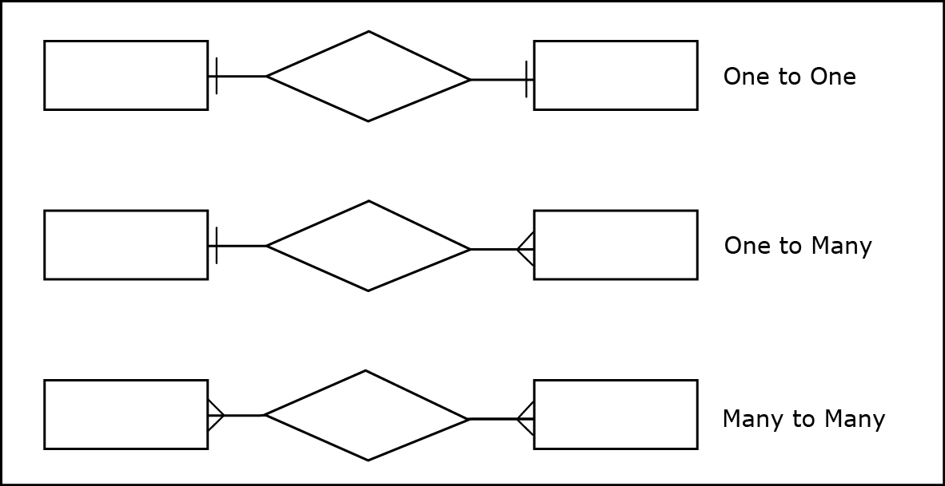
RELATIONSHIPS
Three types of relationships (maximum cardinality-wise)

Slide 15
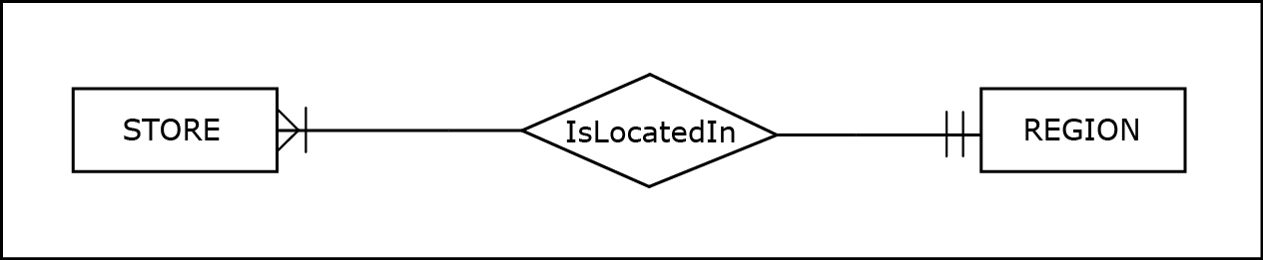
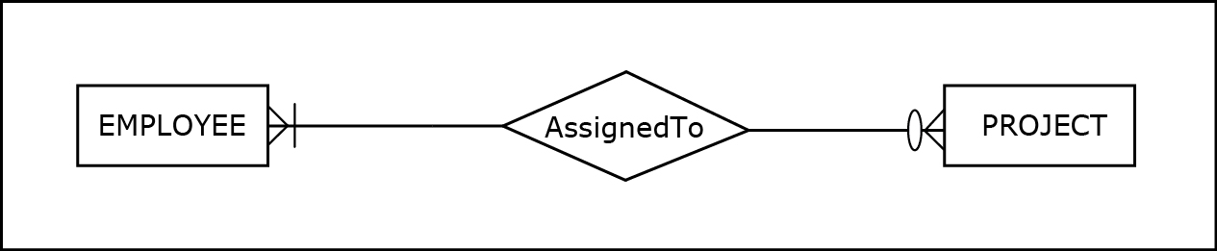
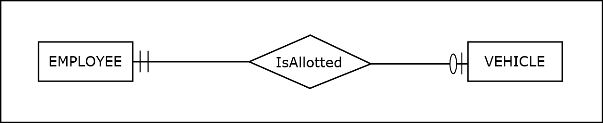
RELATIONSHIPS
A 1:M Relationship
A M:N Relationship
A 1:1 Relationship
Notes:
The requirements for the three relationships (IsLocatedIn, AssignedTo, IsAlloted) are given on Page 20.

Slide 16
RELATIONSHIPS
Relationship instances - occurrences of a relationship
Occur when an instance of one entity is related to an instance of another entity via a relationship
Relationship themselves are depicted in the ER diagrams while relationship instances are not
Relationship instances are eventually recorded in the database that is created based on the ER diagram

Slide 17
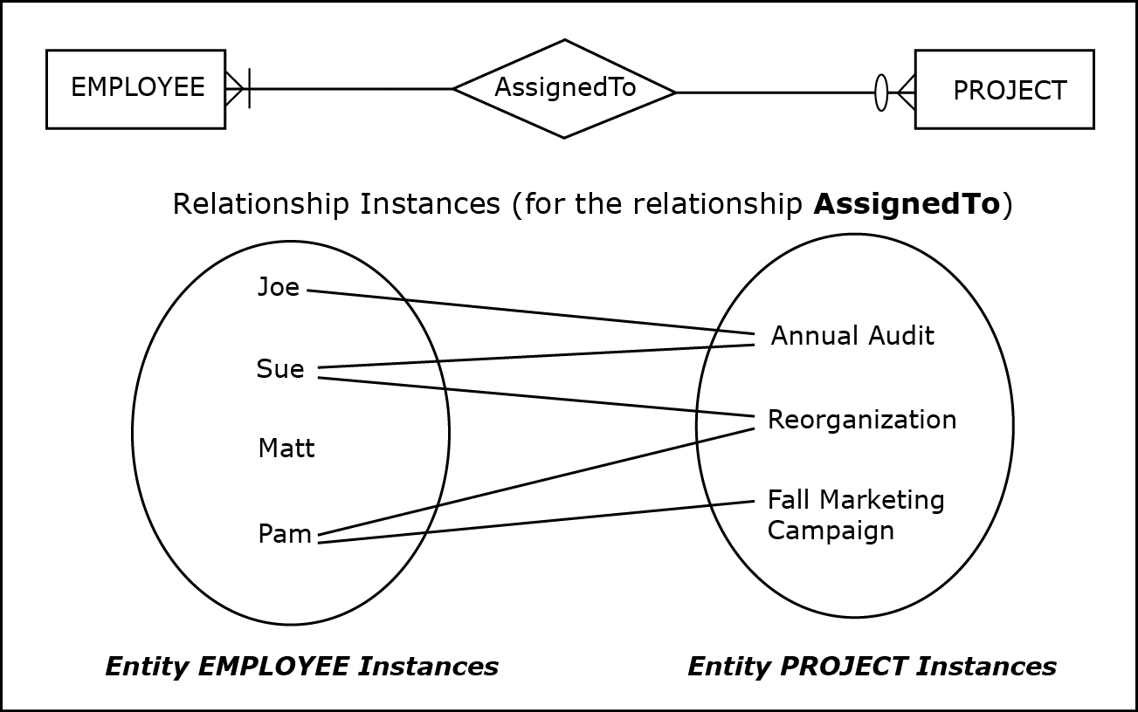
RELATIONSHIPS
A relationship and its instances
Notes:
Illustrated relationship instances reflect the cardinality constraint symbols of the relationship.

Slide 18
RELATIONSHIPS
Relationship attributes
In some cases M:N relationships can actually have attributes of their own
Notes:
An attribute of a 1:M relationship or a 1:1 relationship is never necessary.

Slide 19
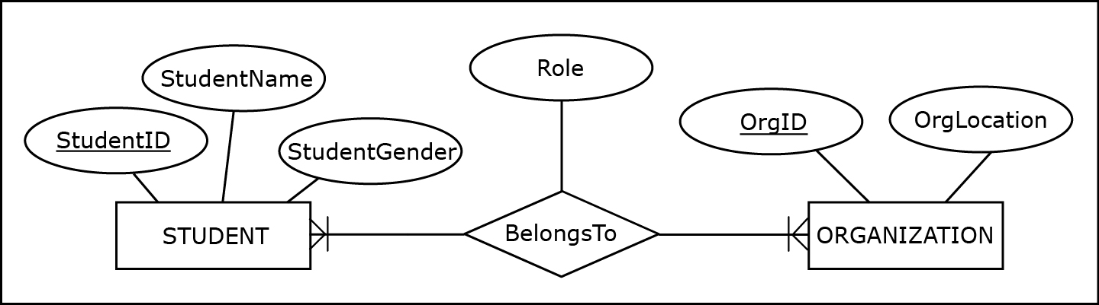
RELATIONSHIPS
A M:N relationship with an attribute
Notes:
The requirements for the ER diagram shown are given on Page 21.

Slide 20
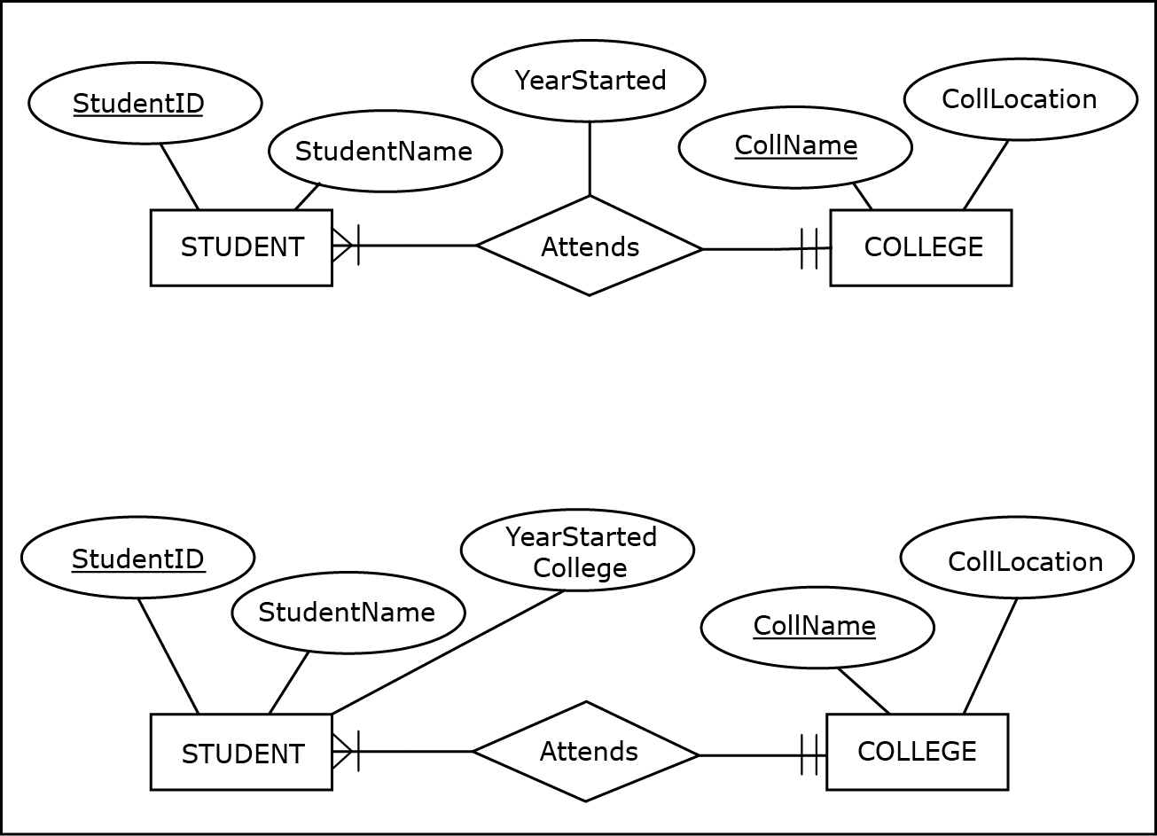
RELATIONSHIPS
A 1:M relationship with and without an attribute
Notes:
The requirements and the discussion of the two ER diagrams shown here are given on Page 22.

Slide 21
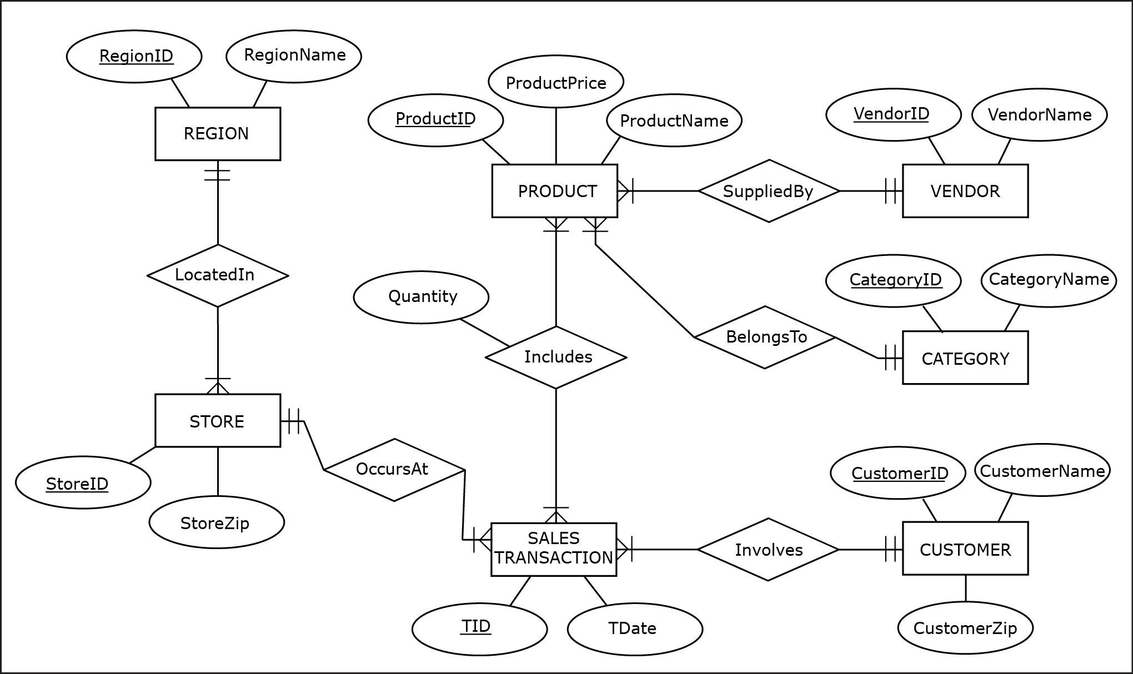
ER diagram example: ZAGI Retail Company Sales Department Database
Jukić, Vrbsky, Nestorov, Sharma – Database Systems
Chapter 2 – Slide 21
Notes:
ZAGI Retail Company Sales Department Database requirements are given on Page 23.
The knowledge of ER notation helps database requirements collectors gather structured and useful requirements for the future database.
Knowing that an ER diagram has to be developed upon the completion of the database requirements process helps database requirements collectors focus on asking the right questions. Examples of such questions are given on Page 24.

Slide 22
ATTRIBUTES
Composite attribute – attribute that is composed of several attributes
Not an additional attribute of an entity
Its purpose is to indicate a situation in which a collection of attributes has an additional meaning, besides the individual meanings of each attribute

Slide 23
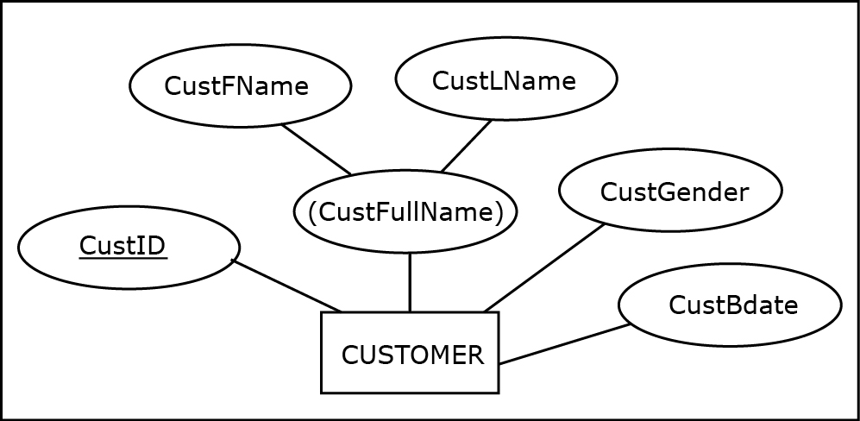
ATTRIBUTES
An entity with a composite attribute
Notes:
This example is discussed on Page 24.

Slide 24
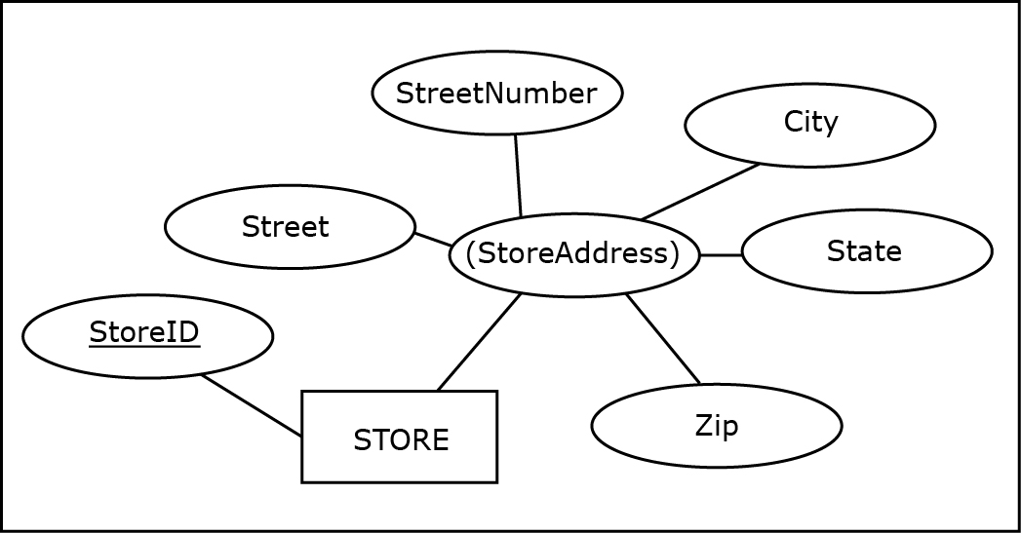
ATTRIBUTES
Another entity with a composite attribute
Notes:
This example is discussed on Page 24.

Slide 25
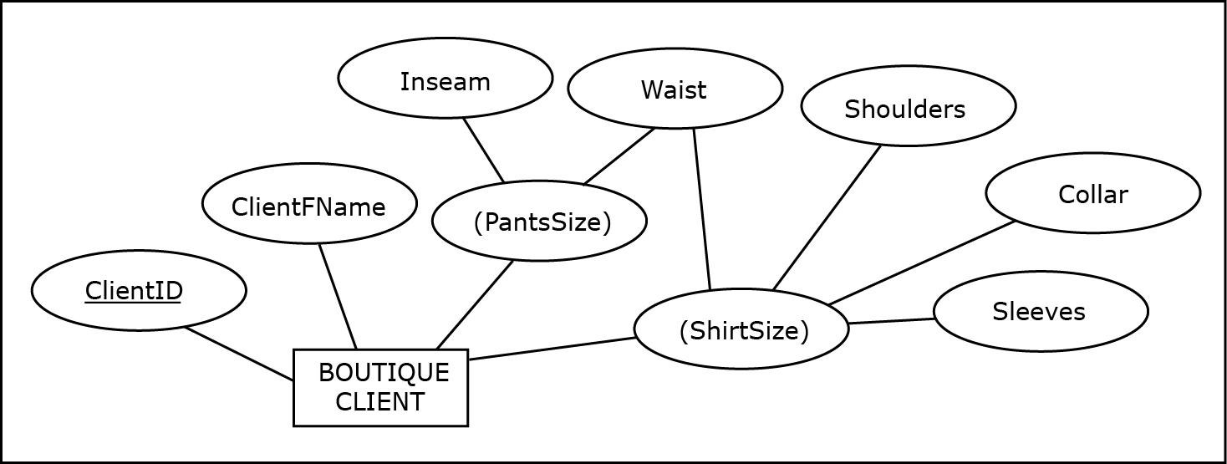
ATTRIBUTES
Composite attributes sharing components
Notes:
This example is discussed on Pages 24-25.

Slide 26
ATTRIBUTES
Composite unique attribute – attribute that is composed of several attributes and whose value is different for each entity instance

Slide 27
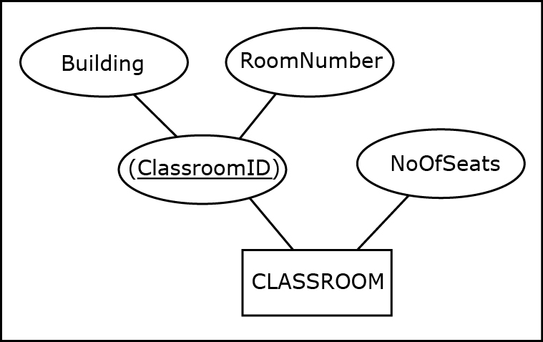
ATTRIBUTES
An entity with a unique composite attribute
Notes:
This example is discussed on Pages 25-26.

Slide 28
ATTRIBUTES
Multiple unique attributes (candidate keys) - when an entity has more than one unique attribute each unique attribute is also called a candidate key
Notes:
The term “candidate key” comes from the fact that a candidate key is a “candidate” to be chosen as the primary identifier (also known as a primary key) when implementing the resulting database. One of the candidate keys is chosen later as the “primary key” for the table corresponding to the entity that contains the candidate keys. Primary keys are discussed in Chapter 3.

Slide 29
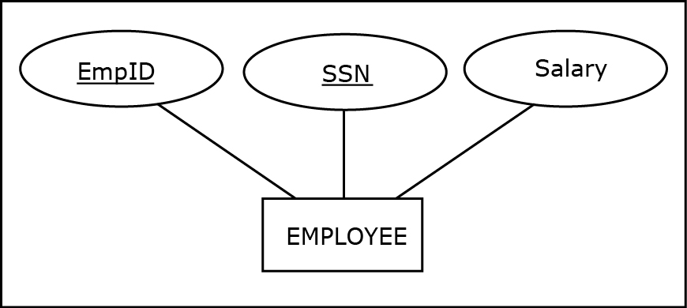
ATTRIBUTES
An entity with multiple unique attributes (candidate keys)
Notes:
This example is discussed on Page 26.

Slide 30
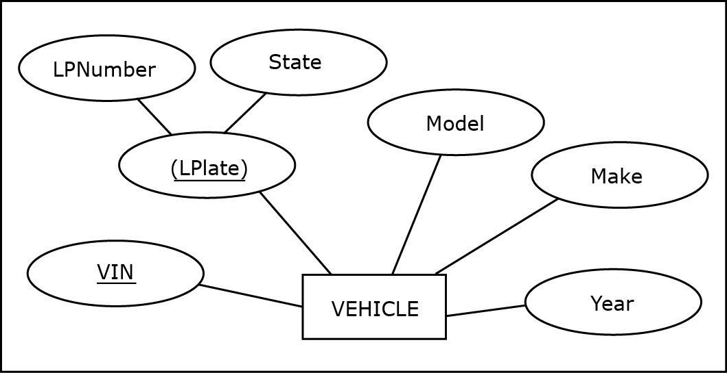
ATTRIBUTES
An entity with a regular and composite candidate key
Notes:
This example is discussed on Page 26.

Slide 31
ATTRIBUTES
Multivalued attribute - attribute for which instances of an entity can have multiple values for the same attribute
Notes:
Used in cases in which there is a variable number of values that can be assigned to the particular attribute of the entity.

Slide 32
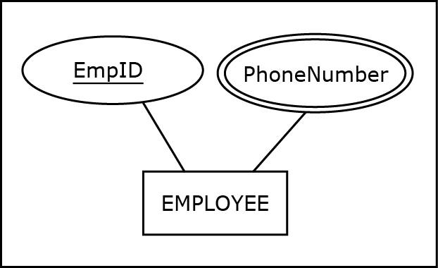
ATTRIBUTES
A multivalued attribute
Notes:
This example is discussed on Page 27.

Slide 33
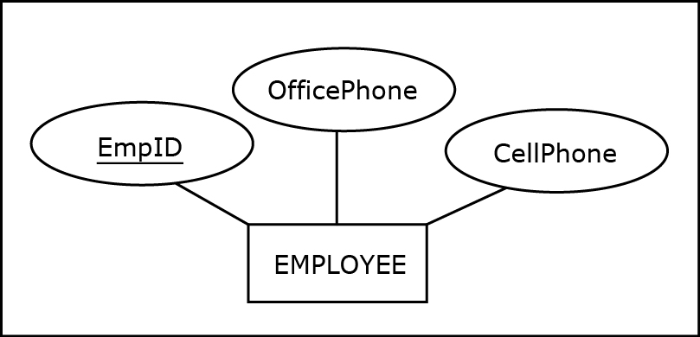
ATTRIBUTES
A scenario that does not use multivalued attributes
Notes:
This example is discussed on Page 27.

Slide 34
ATTRIBUTES
Derived attribute - attribute whose values are calculated and not permanently stored in a database
Notes:
The value of a derived attribute is calculated from the stored values of other attributes and/or additional available data (such as current date).

Slide 35
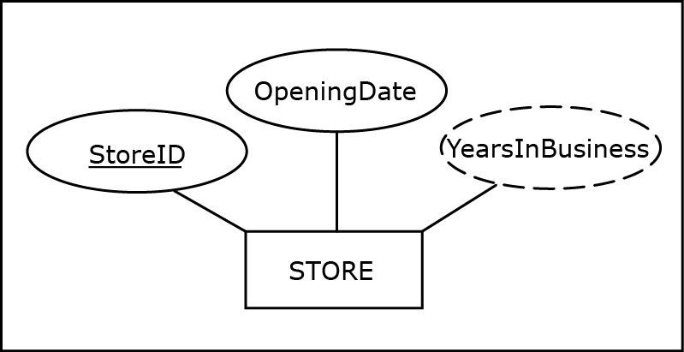
ATTRIBUTES
A derived attribute example
Notes:
This example is discussed on Page 27.

Slide 36
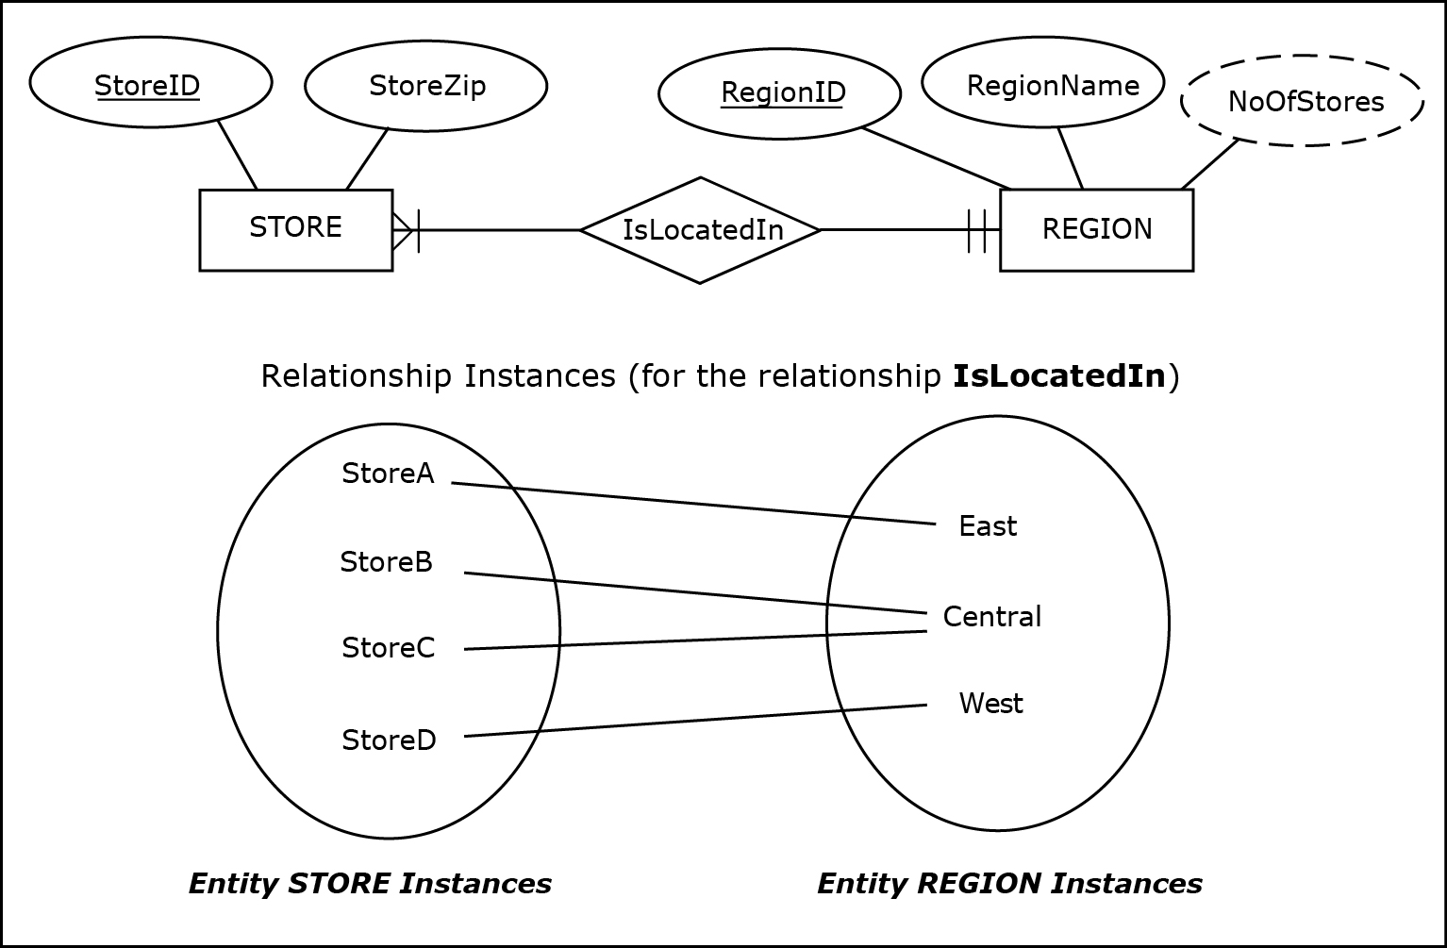
ATTRIBUTES
Another derived attribute example
Notes:
This example is discussed on Page 28.

Slide 37
ATTRIBUTES
Optional attribute - attribute that is allowed to not have a value
Notes:
Typically, most attributes are required attributes (attributes that must have a value for each entity instance). However, some attributes are optional attributes.

Slide 38
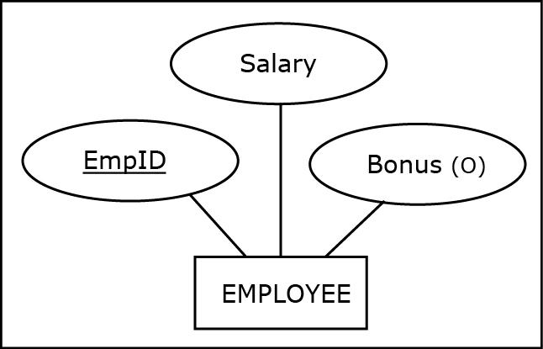
ATTRIBUTES
An optional attribute example
Notes:
This example is discussed on Page 28.

Slide 39
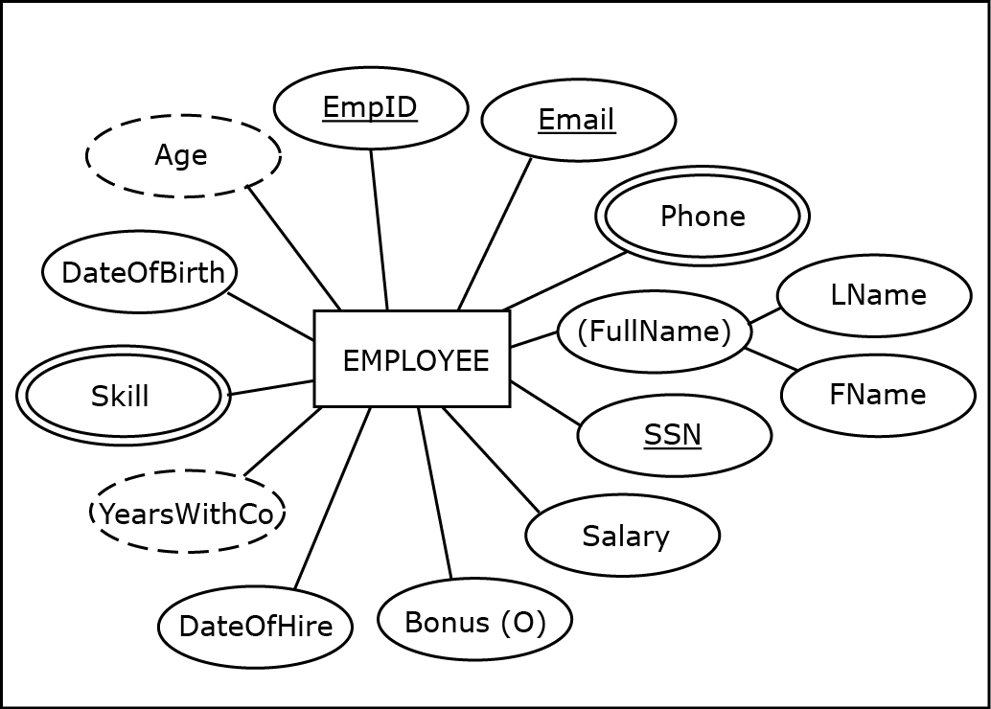
ATTRIBUTES
EXAMPLE: An entity with various types of attributes
Notes:
This example is discussed on Page 29.

Slide 40
RELATIONSHIPS
Exact minimum and maximum cardinality in relationships
In some cases the exact minimum and/or maximum cardinality in relationships is known in advance
Exact minimum/and or maximum cardinalities can be depicted in ER diagrams

Slide 41
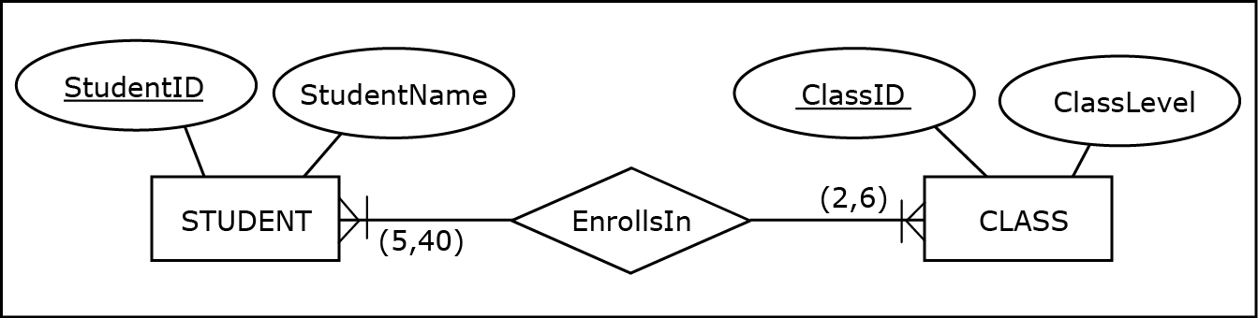
RELATIONSHIPS
A relationship with specific minimum and maximum cardinalities
Notes:
This example is discussed on Page 29.

Slide 42
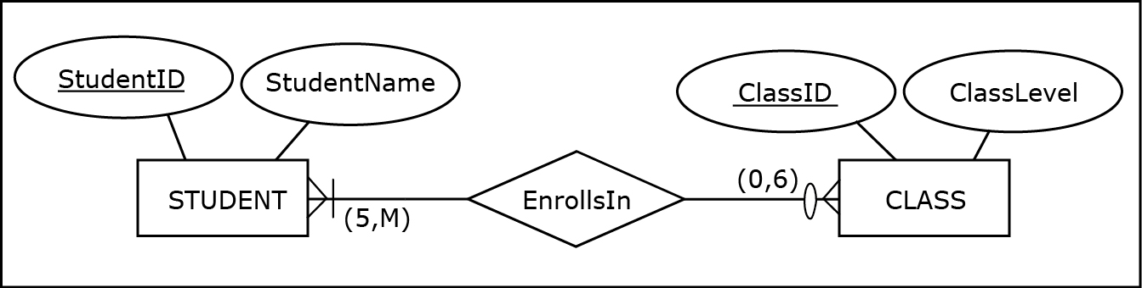
RELATIONSHIPS
A relationship with a mixture of specific and non-specific cardinalities
Notes:
This example is discussed on Page 30.

Slide 43
RELATIONSHIPS
Degree of a relationship - reflects how many entities are involved in the relationship
Binary relationship - relationship between two entities (degree 2 relationship)
Unary relationship (recursive relationship) - occurs when an entity is involved in a relationship with itself (degree 1 relationship)
Notes:
A majority of relationships in business-related ER diagrams are binary relationships.

Slide 44
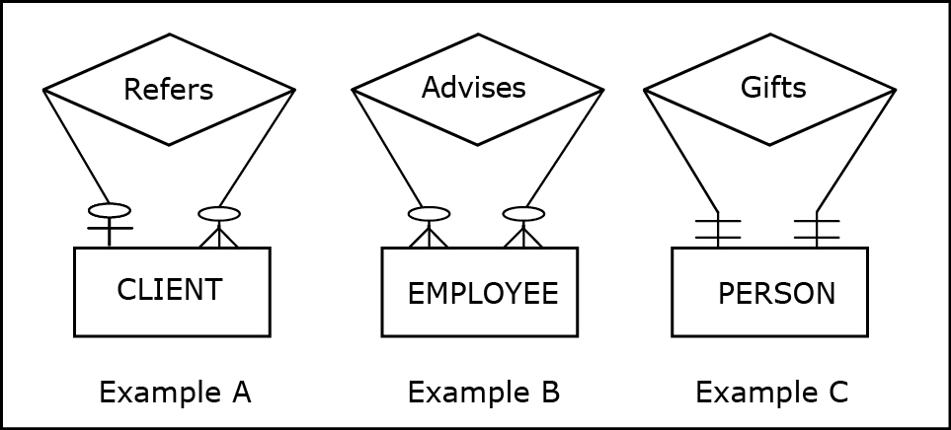
RELATIONSHIPS
Unary relationship examples
Notes:
These examples are discussed on Pages 30-31.

Slide 45
RELATIONSHIPS
Relationship roles - additional syntax that can be used in ER diagrams at the discretion of a data modeler to clarify the role of each entity in a relationship
Notes:
Relationship roles can be used in relationships of any degree, but their usefulness is most apparent when they are used in unary relationships.

Slide 46
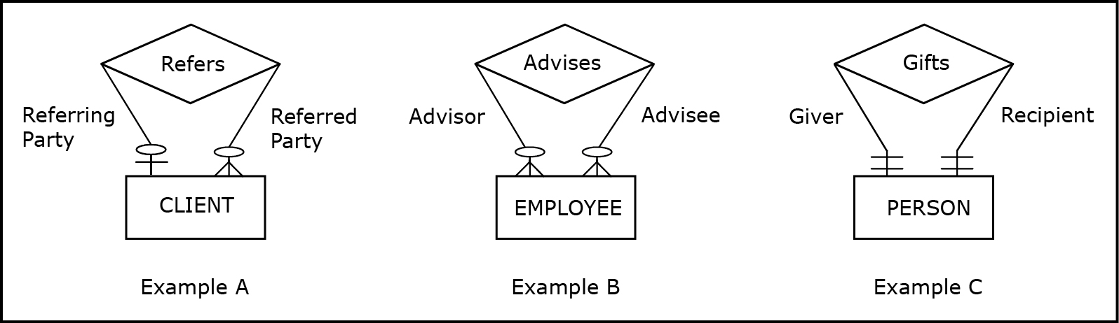
RELATIONSHIPS
Unary relationships with role names
Notes:
These examples are discussed on Page 31.

Slide 47

RELATIONSHIPS
A binary relationship with role names
Notes:
The same ER diagram without the relationship roles would be just as informative, while containing less verbiage.

Slide 48
RELATIONSHIPS
Multiple relationships between same entities
Same entities in an ER diagram can be related via more than one relationship

Slide 49
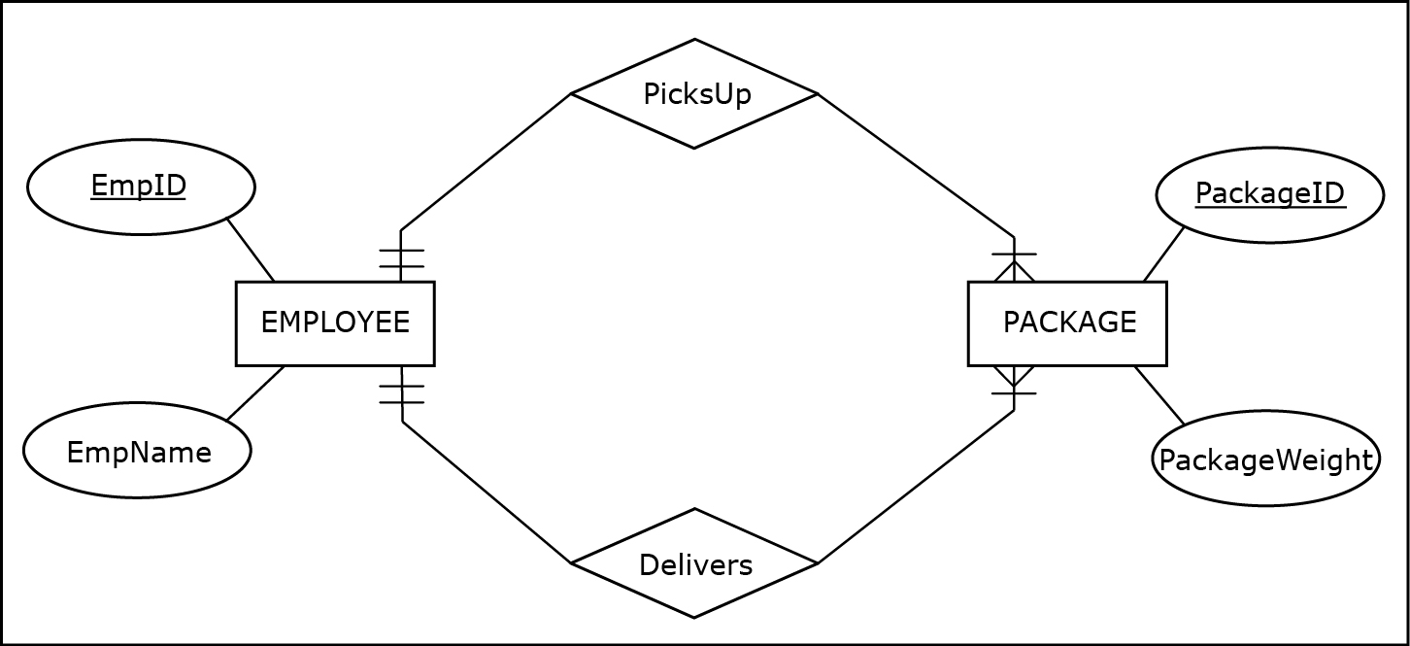
RELATIONSHIPS
Multiple relationships between the same entities
Notes:
This example is discussed on Page 32.

Slide 50
WEAK ENTITY
Weak entity - ER diagram construct depicting an entity that does not have a unique attribute of its own
Owner entity - entity whose unique attribute provides a mechanism for identifying instances of a weak entity
Identifying relationship - relationship between a weak entity and its owner entity in which each instance of a weak entity is associated with exactly one instance of an owner entity
Each weak entity must be associated with its owner entity via an identifying relationship
Unique attribute from the owner entity uniquely identifies every instance of the weak entity via an identifying relationship

Slide 51
WEAK ENTITY
Partial key - attribute of a weak entity that combined with the unique attribute of the owner entity uniquely identifies the weak entity's instances
Combination of the partial key and the unique attribute from the owner entity uniquely identifies every instance of the weak entity

Slide 52
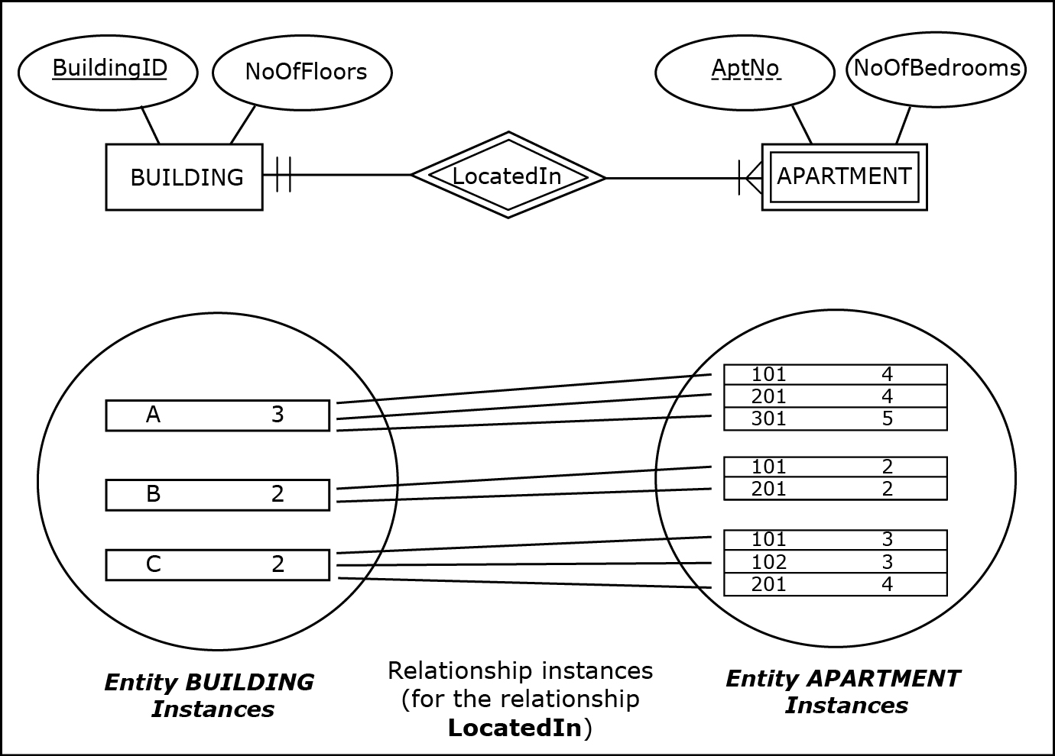
WEAK ENTITY
A weak entity example with entity instances
Notes:
This example is discussed on Pages 32-33.

Slide 53
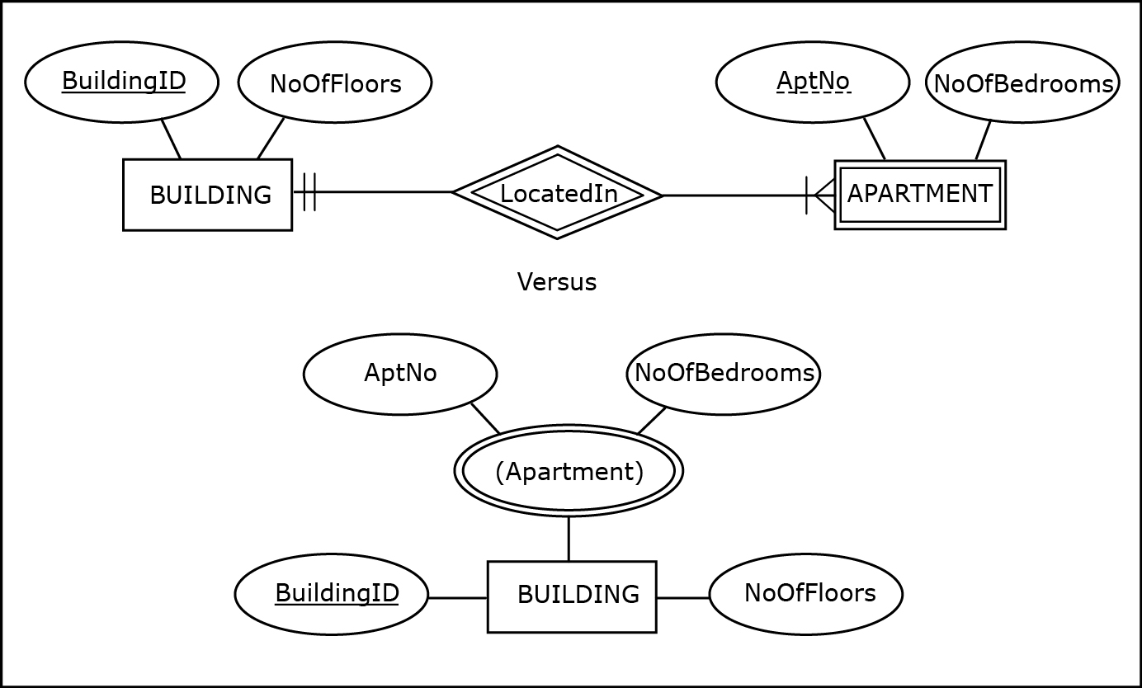
WEAK ENTITY
A weak entity versus a multivalued composite attribute
Notes:
This example is discussed and a comparison between weak entities and multivalued composite attributes is given on Page 34.

Slide 54
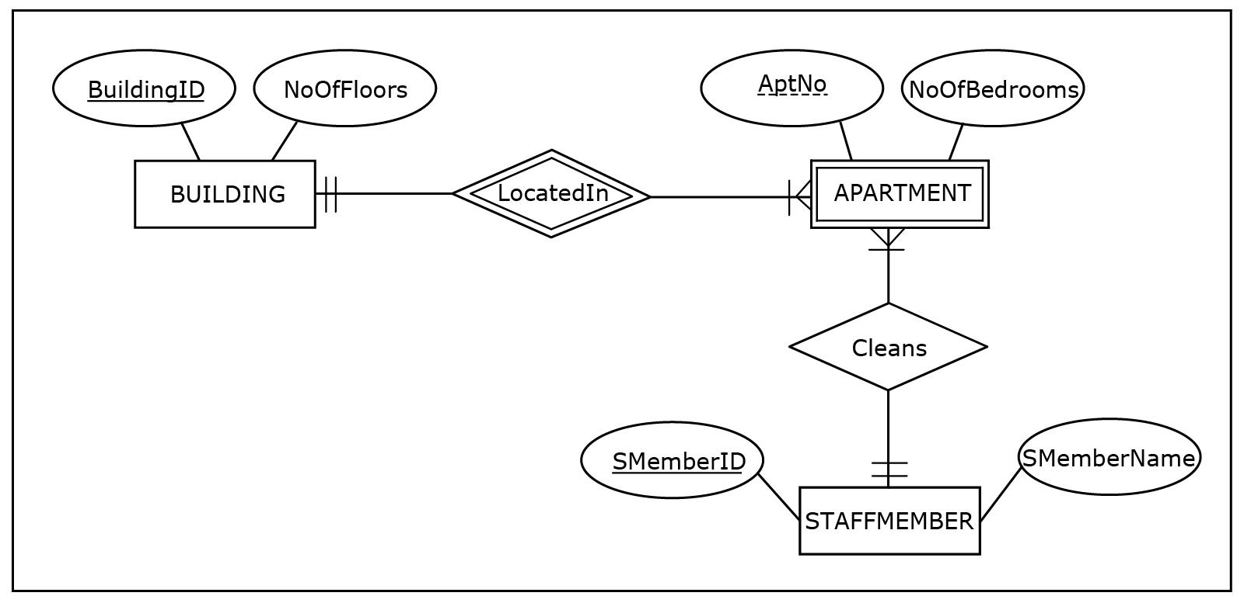
WEAK ENTITY
A weak entity with an identifying and regular relationship
Notes:
This example is discussed on Page 34.

Slide 55
WEAK ENTITY
Identifying relationship is either 1:M or 1:1 relationship
In case of 1:M identifying relationship, a weak entity must have a partial key attribute
In case of 1:1 identifying relationship, a weak entity doesn’t need to have a partial key attribute

Slide 56
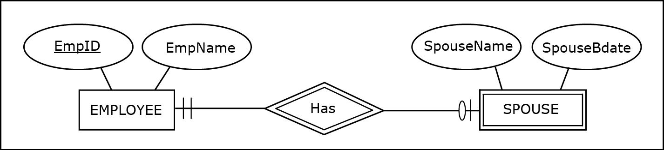
WEAK ENTITY
A weak entity with a 1:1 identifying relationship
Notes:
This example is discussed on Pages 34-35.

Slide 57
NAMING CONVENTIONS FOR ER DIAGRAMS
Entities and attributes
Use singular (rather than plural) nouns
Relationships
Use verbs or verb phrases, rather than nouns
Notes:
For example:
- entity names STUDENT, STORE, and PROJECT are better choices than STUDENTS, STORES and PROJECTS
- attribute name Phone is a better choice than the attribute name Phones
- relationship names Inspects, Manages, and BelongsTo are better choices than Inspection, Management and Belonging

Slide 58
NAMING CONVENTIONS FOR ER DIAGRAMS
Names should be as brief as possible, without being too condensed as to obscure the meaning of the construct
If possible, give all attributes in the entire ER diagram different names
Notes:
For example:
- entity name STUDENT is a better choice than UNIVERSITY STUDENT (unnecessarily wordy) or US (too cryptic)
- use EmpName and CustName as names for attributes of entities EMPLOYEE and CUSTOMER respectively, instead of name Name for both attributes

Slide 59
MULTIPLE ER DIAGRAMS
When depicting multiple ER diagrams, each diagram should be visualized separately
Instead of multiple ER diagrams in one schema a better choice is to present each ER diagram separately

Slide 60
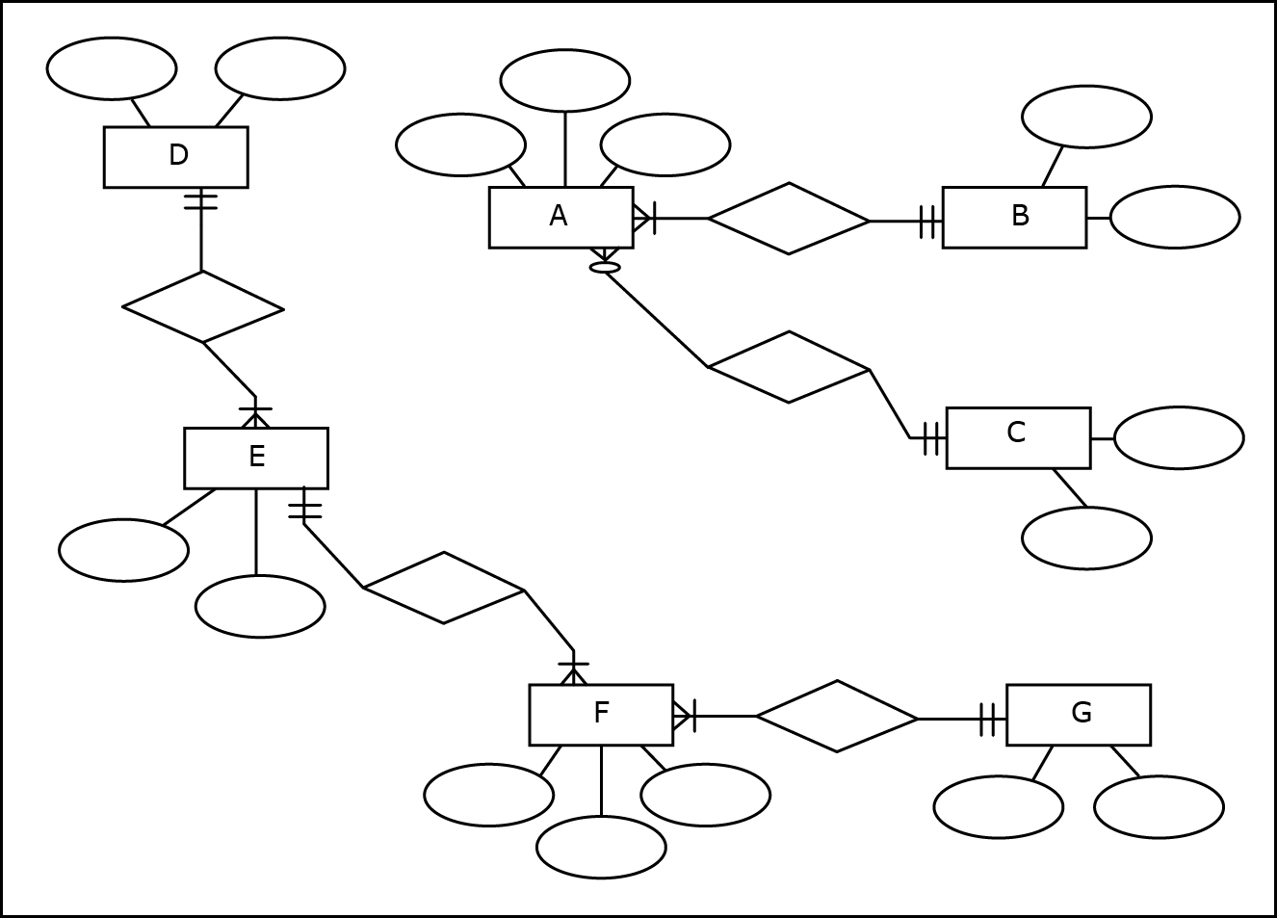
MULTIPLE ER DIAGRAMS
A schema with two separate ER diagrams (potentially misleading)
Notes:
This example is discussed on Pages 35-37.

Slide 61
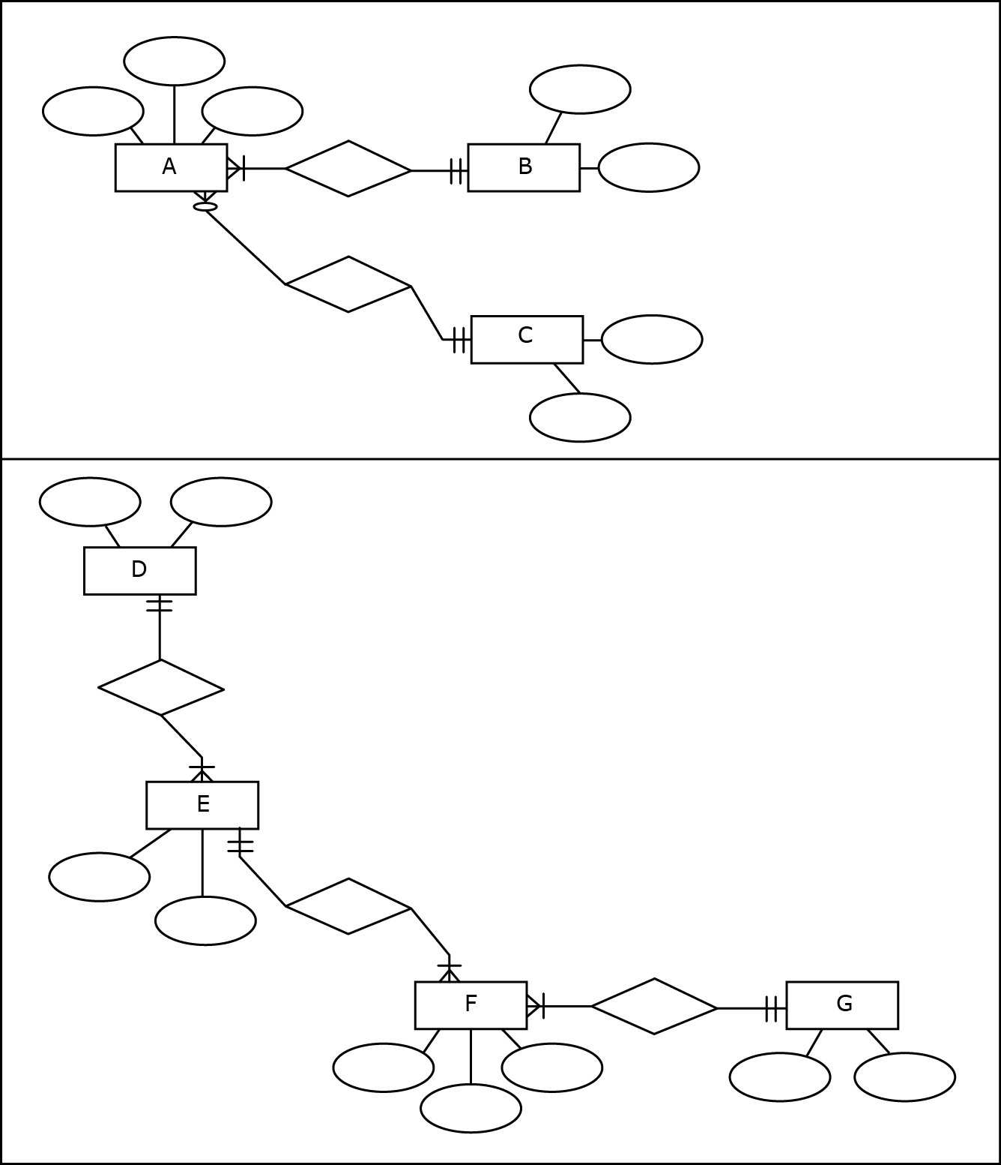
MULTIPLE ER DIAGRAMS
Separate ER diagrams in separate schemas
Notes:
This example is discussed on Pages 35-37.

Slide 62
MULTIPLE ER DIAGRAMS
Separate ER diagrams in separate schemas
Notes:
This example is discussed on Pages 35-37.

Slide 63
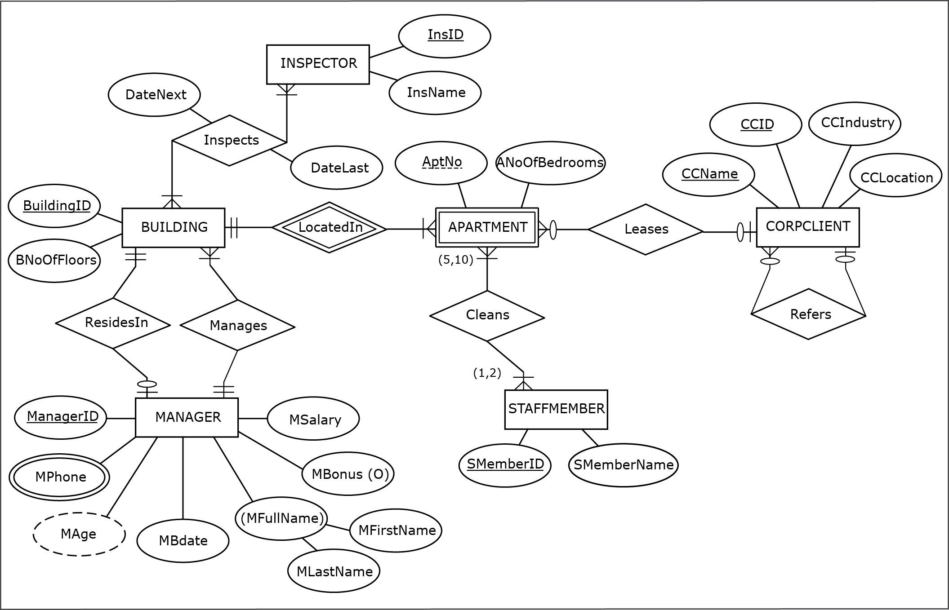
Another ER diagram example: HAFH Realty Company Property Management Database
Jukić, Vrbsky, Nestorov, Sharma – Database Systems
Chapter 2 – Slide 63
Notes:
HAFH Realty Company Property Management Database requirements are given on Pages 37-38.

Slide 64
DATABASE REQUIREMENTS AND ER MODEL USAGE
ER modeling provides a straightforward technique for collecting, structuring, and visualizing requirements
An understanding of ER modeling is crucial, not just for creating ER models based on the requirements, but also during the requirements collection process itself
It helps keep the focus on asking or seeking answers to the right questions in order to establish the relevant facts about entities, attributes, and relationships

Slide 65
DATABASE REQUIREMENTS AND ER MODEL USAGE
One of the common mistakes that beginners make when engaging in ER modeling for the first time is not recognizing the difference between an entity and the ER diagram itself

Slide 66
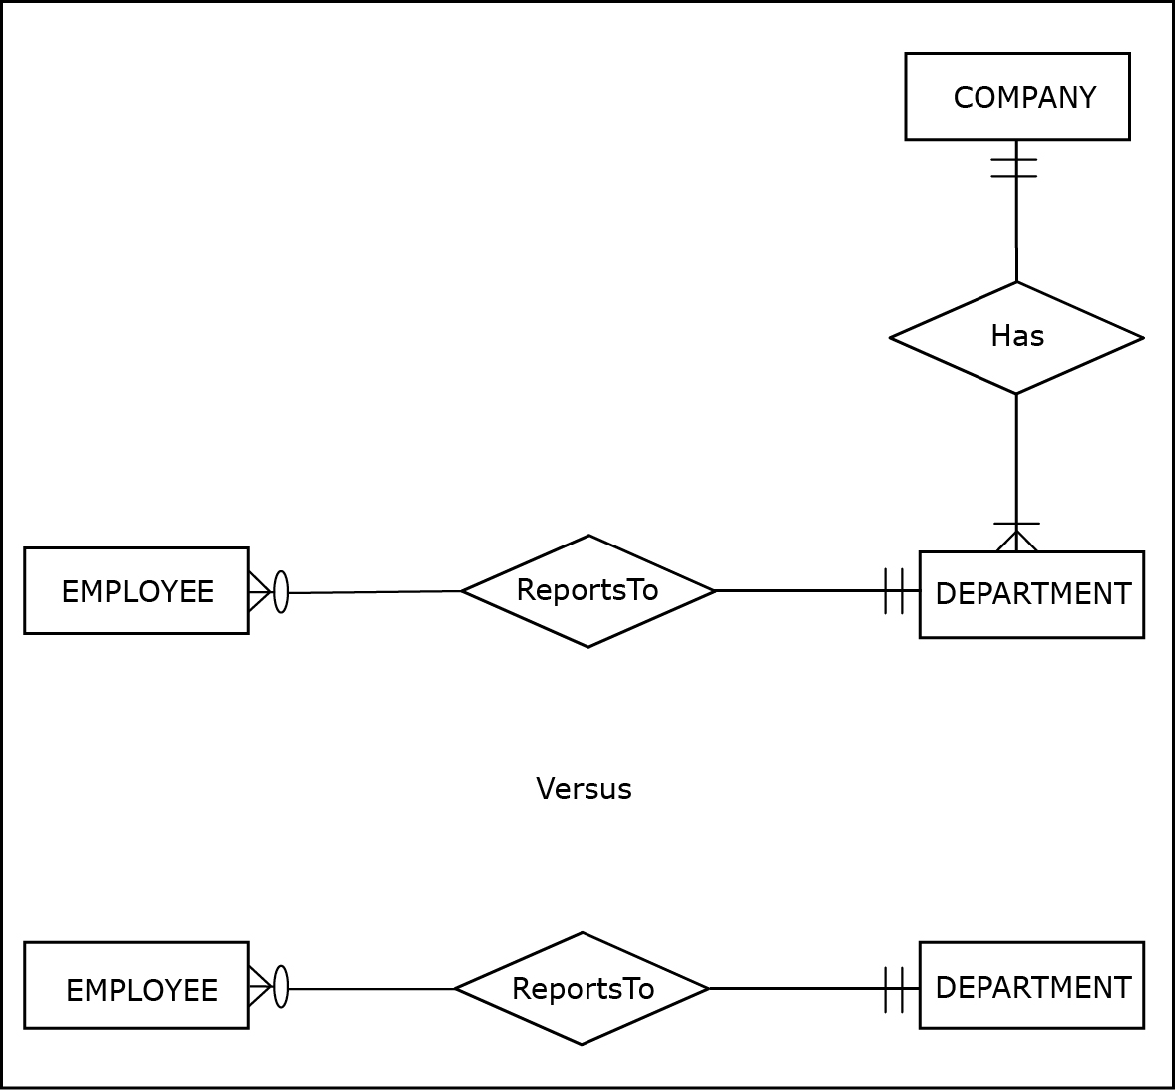
DATABASE REQUIREMENTS AND ER MODEL USAGE
An ER diagram incorrectly and correctly interpreting requirements
Notes:
This example is discussed on Page 38.

Slide 67
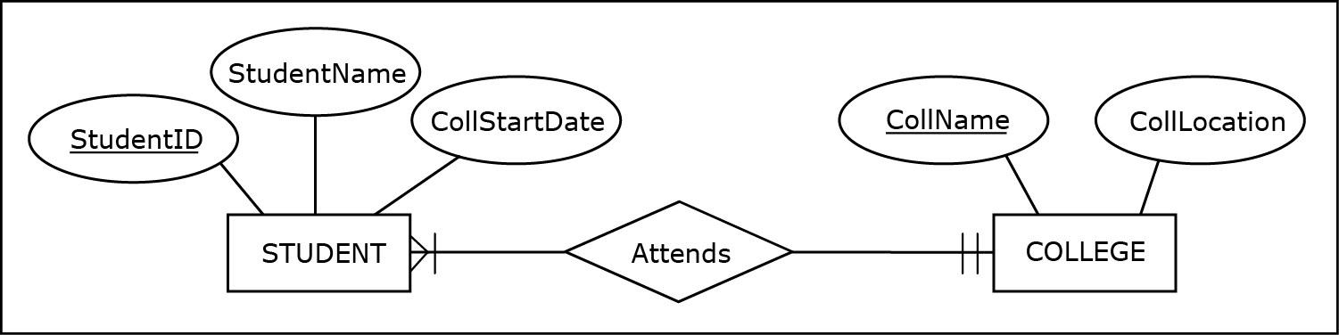
DATABASE REQUIREMENTS AND ER MODEL USAGE
An ER diagram incorrectly and correctly interpreting requirements
Notes:
This example is discussed on Pages 38-39.

Slide 68
DATABASE REQUIREMENTS AND ER MODEL USAGE
Another common database requirements collection and ER modeling mistake made by novices is not distinguishing between:
Modeling of the data that is wanted and can be kept track of
versus
Modeling of everything that takes place in an organization

Slide 69
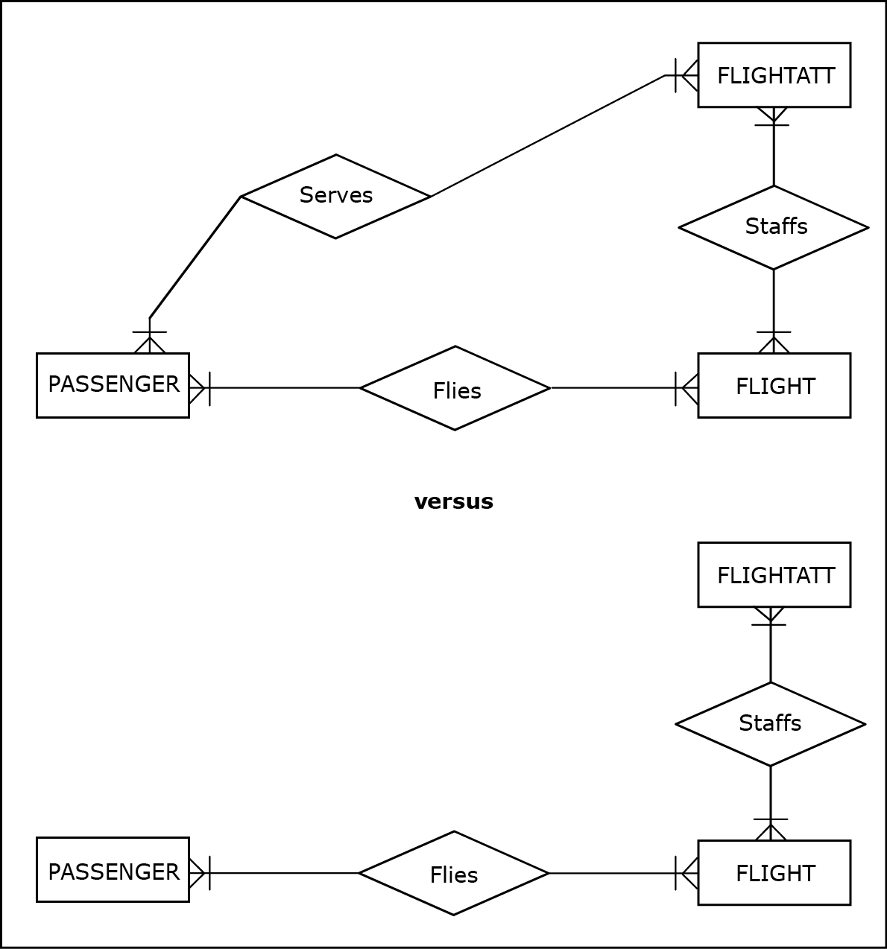
DATABASE REQUIREMENTS AND ER MODEL USAGE
ER diagrams based on unfeasible vs. proper requirements
Notes:
This example is discussed on Pages 39-40.

Slide 70
VARIOUS ER NOTATIONS
There is no universally adopted ER notation to which all database projects conform
Instead, there is a variety of available ER notations in use
However, if a designer is familiar with one ER notation, other alternative ER notations are easy to understand and use

Slide 71
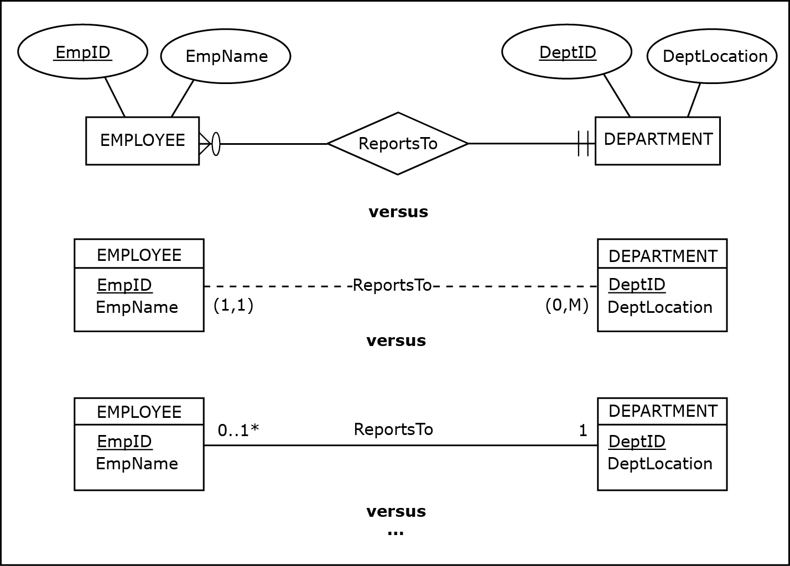
VARIOUS ER NOTATIONS
Examples of various ER notations
Notes:
These notations are discussed on Page 41.

Slide 72
M:N RELATIONSHIPS WITH MULTIPLE INSTANCES BETWEEN THE SAME ENTITIES
In some cases, M:N relationships can have multiple occurrences between the same instances of involved entities
The following examples illustrates such cases

Slide 73
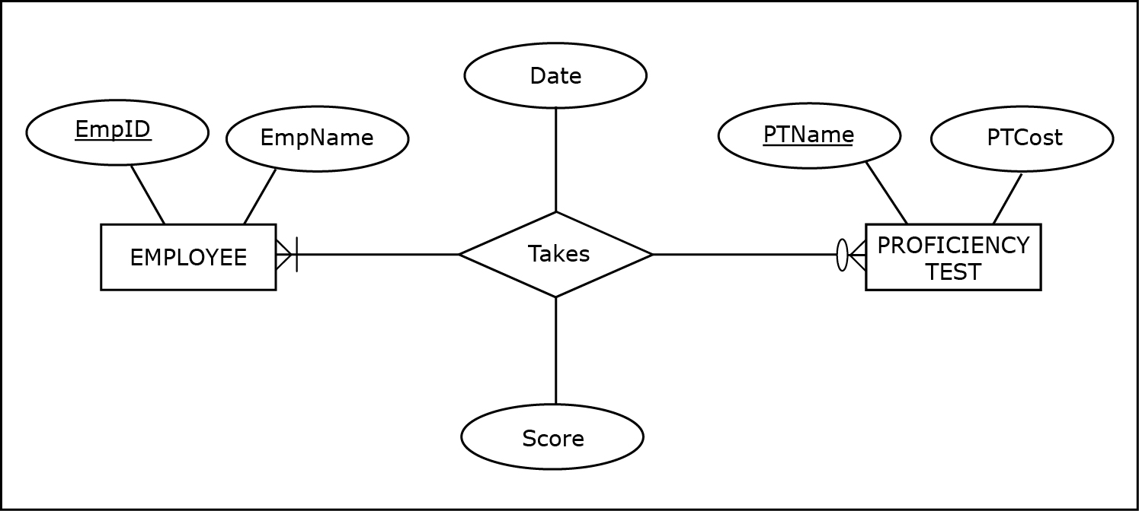
M:N RELATIONSHIPS WITH MULTIPLE INSTANCES BETWEEN THE SAME ENTITIES
An ER diagram for an M:N relationship depicting students completing classes
Notes:
This example is discussed on Pages 42-44.

Slide 74
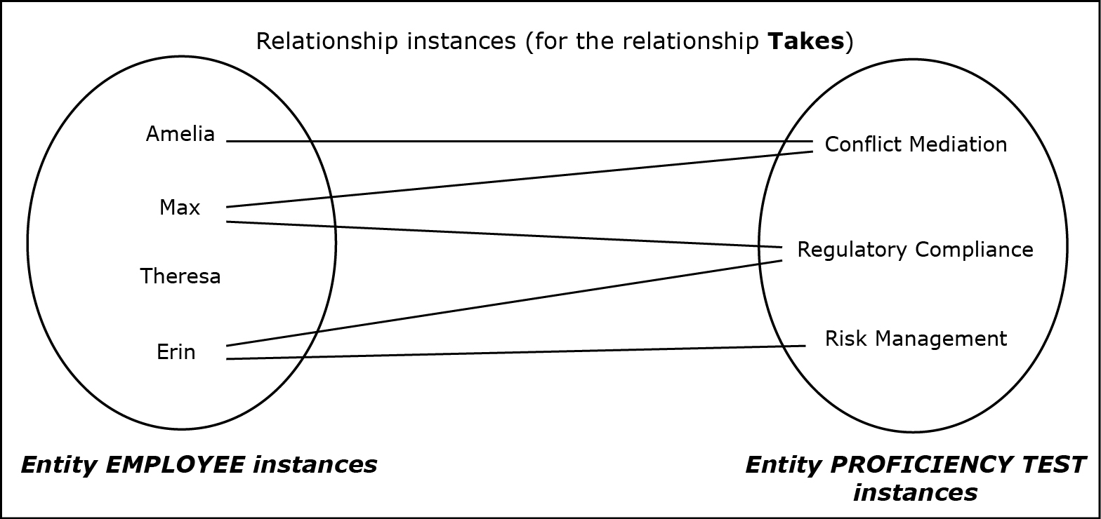
M:N RELATIONSHIPS WITH MULTIPLE INSTANCES BETWEEN THE SAME ENTITIES
Instances of the M:N relationship Completes
Notes:
This example is discussed on Pages 42-44.

Slide 75
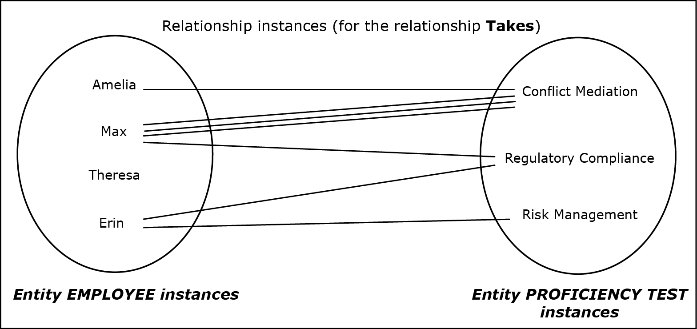
M:N RELATIONSHIPS WITH MULTIPLE INSTANCES BETWEEN THE SAME ENTITIES
Instances of the M:N relationship Completes with an additional requirement
Notes:
This example is discussed on Pages 42-44.

Slide 76
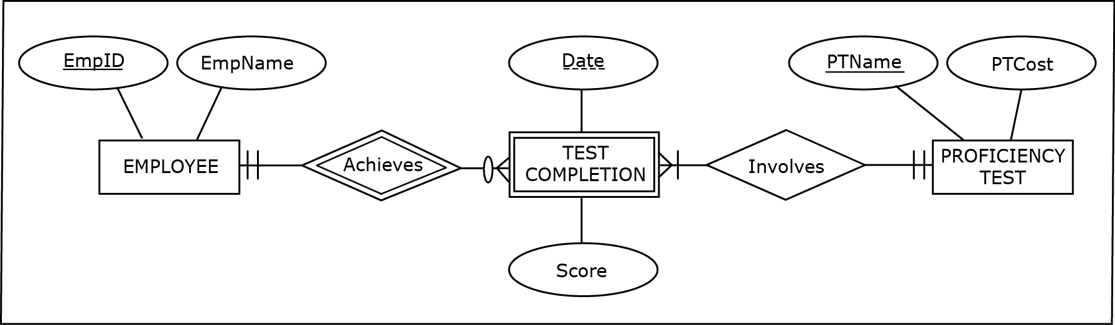
M:N RELATIONSHIPS WITH MULTIPLE INSTANCES BETWEEN THE SAME ENTITIES
An ER diagram for an M:N relationship represented as a weak entity
Notes:
This example is discussed on Pages 42-44

Slide 77
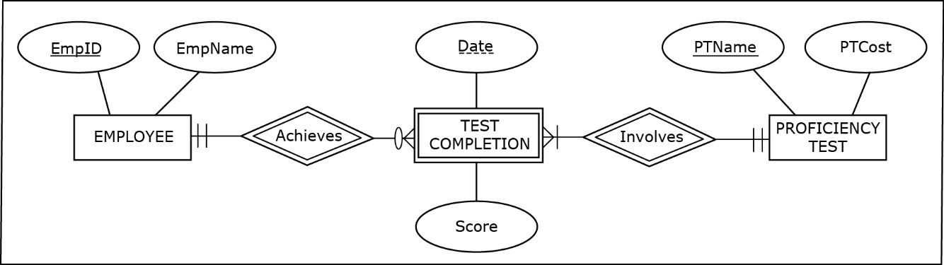
M:N RELATIONSHIPS WITH MULTIPLE INSTANCES BETWEEN THE SAME ENTITIES
An ER diagram for an M:N relationship represented as a weak entity
Notes:
This example is discussed on Pages 42-44

Slide 78
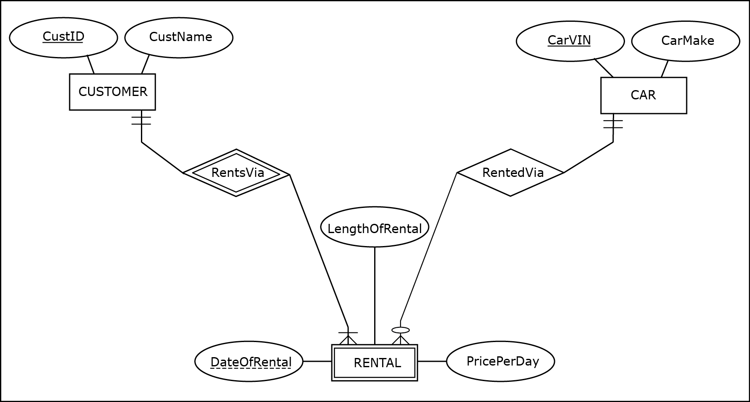
M:N RELATIONSHIPS WITH MULTIPLE INSTANCES BETWEEN THE SAME ENTITIES
Another M:N relationship represented as a weak entity
Notes:
This example is discussed on Pages 44-46.

Slide 79
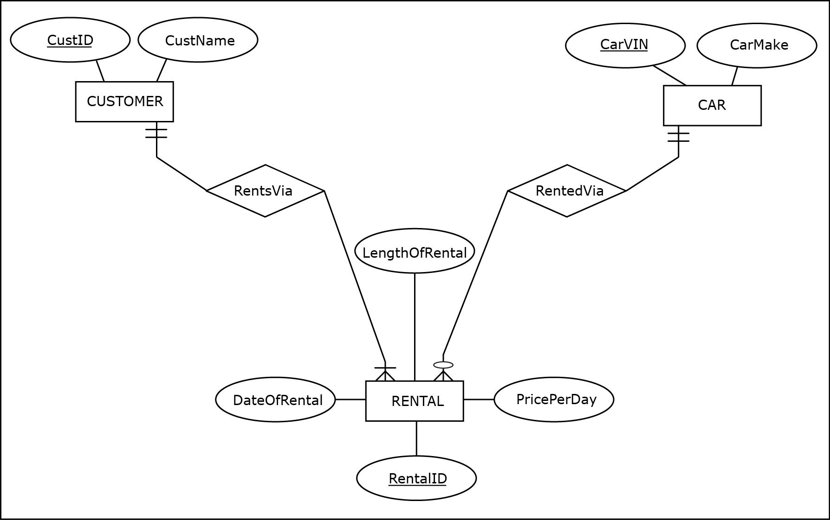
M:N RELATIONSHIPS WITH MULTIPLE INSTANCES BETWEEN THE SAME ENTITIES
A regular entity, instead of an M:N relationship represented as a weak entity
Notes:
This example is discussed on Pages 44-46.

Slide 80
ASSOCIATIVE ENTITY
Associative entity - construct used as an alternative way of depicting M:N relationships
Associative entities do not have unique or partially unique attributes, and often do not have any attributes at all

Slide 81
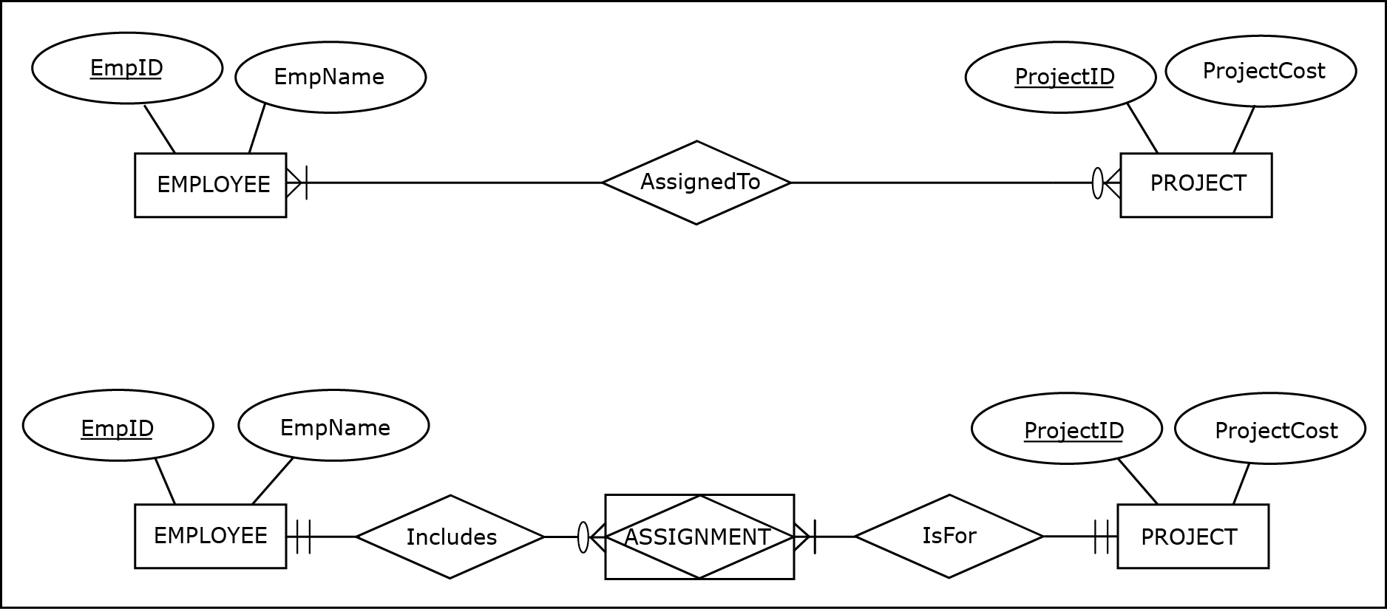
ASSOCIATIVE ENTITY
An identical relationship represented as a M:N relationship and as an associative entity
Notes:
This example is discussed on Page 46.

Slide 82

ASSOCIATIVE ENTITY
An identical relationship represented as a unary M:N relationship and as an associative entity
Notes:
This example is discussed on Pages 46-47.

Slide 83

ASSOCIATIVE ENTITY
An identical relationship represented as an M:N relationship with an attribute and as an associative entity with an attribute
Notes:
This example is discussed on Pages 47-48.

Slide 84
ASSOCIATIVE ENTITY
For relationships with a degree higher than 2 such as ternary relationships, associative entities provide a way to eliminate potential ambiguities in the ER diagrams
Notes:
Associative entities are not necessary constructs for depicting binary or unary relationships (for binary or unary relationships, associative entities are simply another way of depicting a relationship).

Slide 85
TERNARY RELATIONSHIP
Ternary relationship - relationship involving three entities (degree 3 relationship)

Slide 86

TERNARY RELATIONSHIP
Three binary relationships that are insufficient for depicting given requirements
Notes:
This example is discussed on Pages 48-51.

Slide 87

TERNARY RELATIONSHIP
A ternary relationship
Notes:
This example is discussed on Pages 48-51.

Slide 88

TERNARY RELATIONSHIP
A ternary relationship via associative entity
Notes:
This example is discussed on Pages 48-51.

Slide 89

TERNARY RELATIONSHIP
A regular entity replacing a ternary relationship
Notes:
This example is discussed on Pages 48-51.

Slide 90

TERNARY RELATIONSHIP
A many-to-many-to-one ternary relationship
Notes:
This example is discussed on Pages 48-51.

Slide 91

TERNARY RELATIONSHIP
A many-to-many-to-one ternary relationship
Notes:
This example is discussed on Pages 48-51.

Slide 92
TERNARY (AND HIGHER DEGREE) RELATIONSHIPS
In practice, ternary relationships are relatively rare, and relationships of degree higher than 3 are rarer still
Notes:
In most cases when a designer is tempted to create relationships of degrees higher than 2, he or she should explore the possibility of creating additional entities instead.

Slide 93
REDUCING THE NUMBER OF ATTRIBUTES
Reducing the number of attributes by treating some attributes as attribute values
In some cases, it may be appropriate to consider whether an originally designed attribute can be treated as an attribute value instead
Valid alternative in some circumstances (but not always)
Notes:
In most cases when a designer is tempted to create relationships of degrees higher than 2, he or she should explore the possibility of creating additional entities instead.

Slide 94

REDUCING THE NUMBER OF ATTRIBUTES
Example of reducing the number of attributes by treating some attributes as attribute values:
Notes:
This example is discussed on Pages 51-52.

Slide 95

REDUCING THE NUMBER OF ATTRIBUTES
Example of reducing the number of attributes by treating some attributes as attribute values:
Notes:
This example is discussed on Pages 51-52.

